Slide 1

NEU MINGLE
Ganesh Patil| Keerthana Panyam | Naiya Adatiya | Sravani Banala
________________________________________________________________

Slide 2
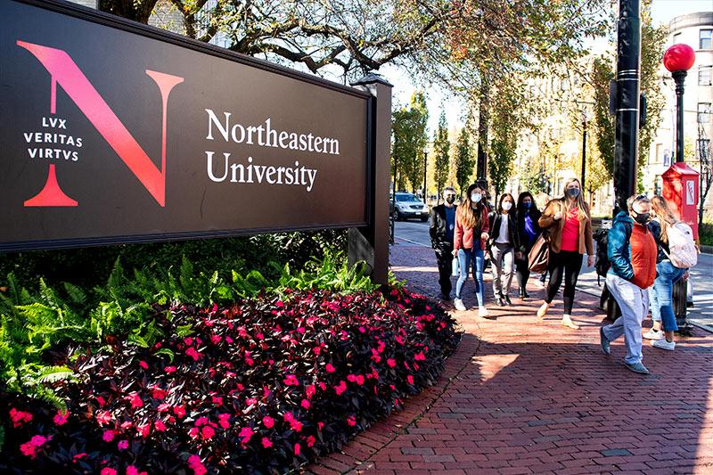
Table of Contents
Design & Analysis
Motivation
01
02
Implementation
03
04
Technology Used

Slide 3
01
Motivation
Northeastern provides the platform to interact and to connect so that motivated us to implement a app for northeastern where students can connect with each other.
This application will help student to get the highlights about events, friend’s updates and make them mingle with each other.

Slide 4
The Idea
Northeastern promotes interaction among students, The aim of this application is to make student’s connections and give them knowledge about their peers and alumni.
This apps have several features that highlights location , Event navigation and links that to calendar.
The objective of NEU Mingle includes chat features where student’s can discuss among themselves or with alumni and Polls on trending things happening around northeastern.
NEU Mingle is built using MongoDB, React and express which Mainly focuses on features like linking dashboard, events , discover tabs.

Slide 5
The idea is to develop a website which will allow Northeastern Students to interact and collaborate with their peers seek guidance. All users can join discussion clubs of their interest. Students can plan their tasks and register for recommended events through Calendar Interface.
Regular polls on various topics related to the university, event registration and navigation, discussion chat groups, connections with other students are some of our key features.

Slide 6
Design:
02
1. Login and Signup : Signup functionality used for students who are first time users to Nu mingle. Students have to provide their details such as name,NUID,email and set password for their login. Login Functionality used for logging by Admin and students.
2. Connect : Connect functionality is used for northeastern students to connect with the peers, friends,students can send the connection requests to the students whom they wish to connect.It's with connect student can develop network .
3. Chat : chat functionality is a messaging platform through which students can communicate with their connections. Student's will be able to fetch and post messages to their connections.

Slide 7
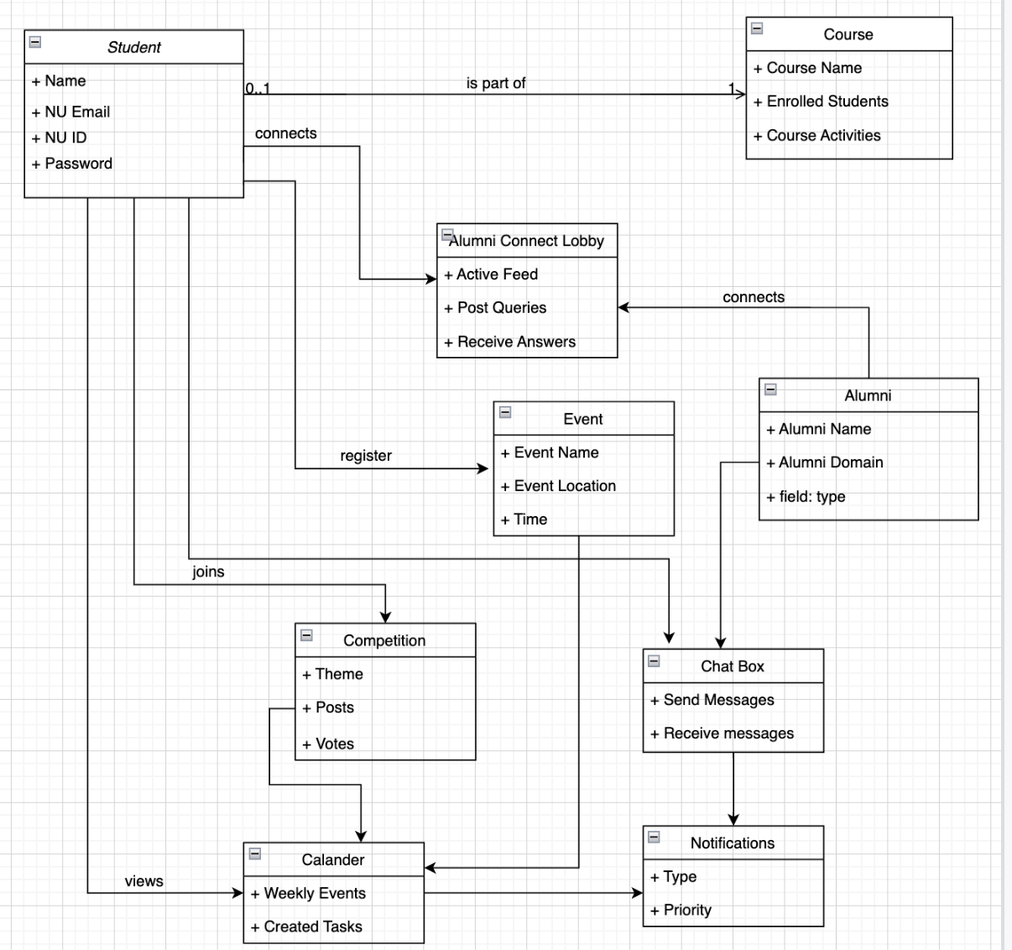
Domain design

Slide 8
Design & Analysis
Our project was designed using two use-cases:
1. Admin
2. User/Student
The Admin gets the same interface as the User/Student wherein they can login into their respective dashboards using their Username and Password. In case of a an admin, they can Create Events, Manage Events, Create Polls, Manage Polls, View All Student/User data.
A Student/User can access their profile by logging in or sign up as long as they have a NUID and email. The students can register for Events, vote in Polls organized by the university, chat with other users, connect with them, join club chat rooms, view their events schedule on Calendar and view notifications and activities of their connections on the Discover tab.

Slide 9
Implementation
03
Student
Admin
Login
Signup
Polls
Events
Discover
Chat
Calendar
Login
Polls
Events
Data of All Students

Slide 10
LOGIN
Student/Admin Login
There is a drop down with two user-cases: Student and Admin
The Log In page asks for the Student email id and Password, before login checking whether the user has filled out all the boxes on the student login page, if not asking user to enter all the fields, then switch to the Student Dashboard if the information was entered correctly
Similarly, Admin can choose themselves from the drop-down adding the Admin's Email ID and Password; if entered correctly, it is switched to Admin Dashboard.
For the Student Signup page we have Name of the student, NUID, email and password.
`

Slide 11
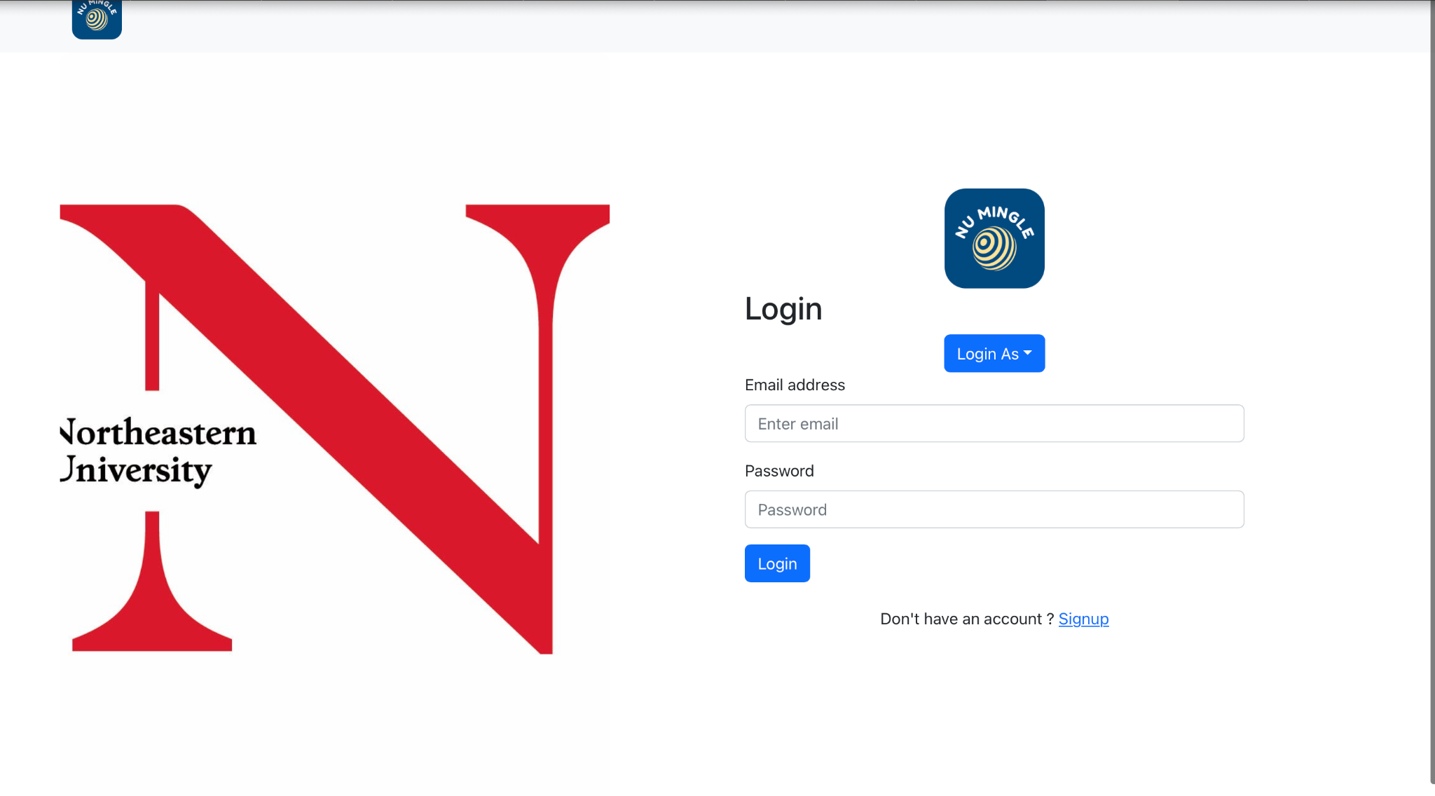
Log In Page

Slide 12
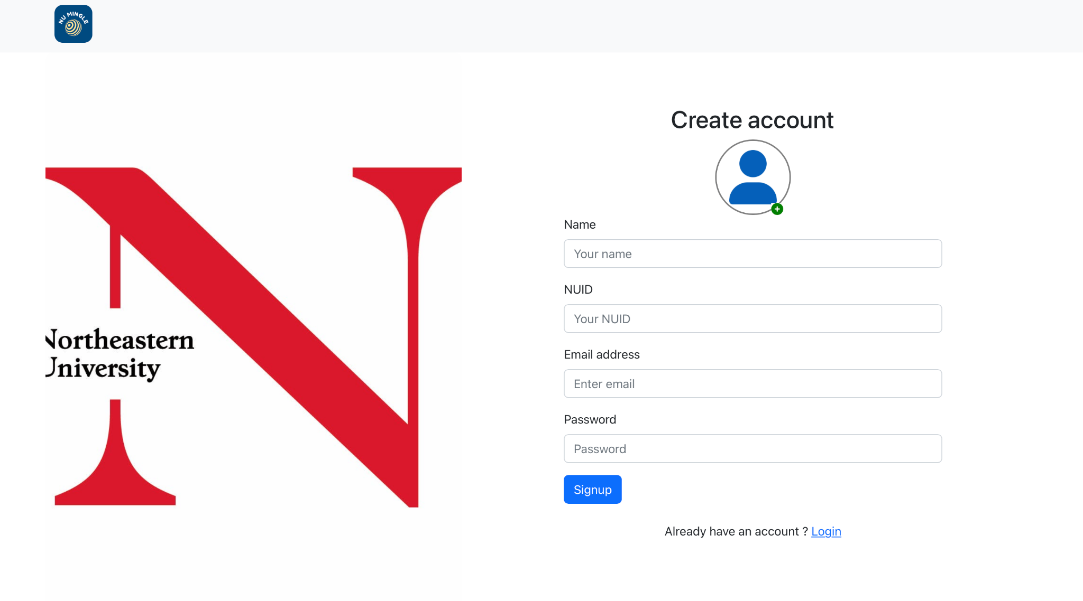
Sign In Page

Slide 13
STUDENT DASHBOARD
The Student Dashboard consists the features:
Connect
Chat
Career Lobby
Events
Discover
Polls
Calendar
Update Profile

Slide 14
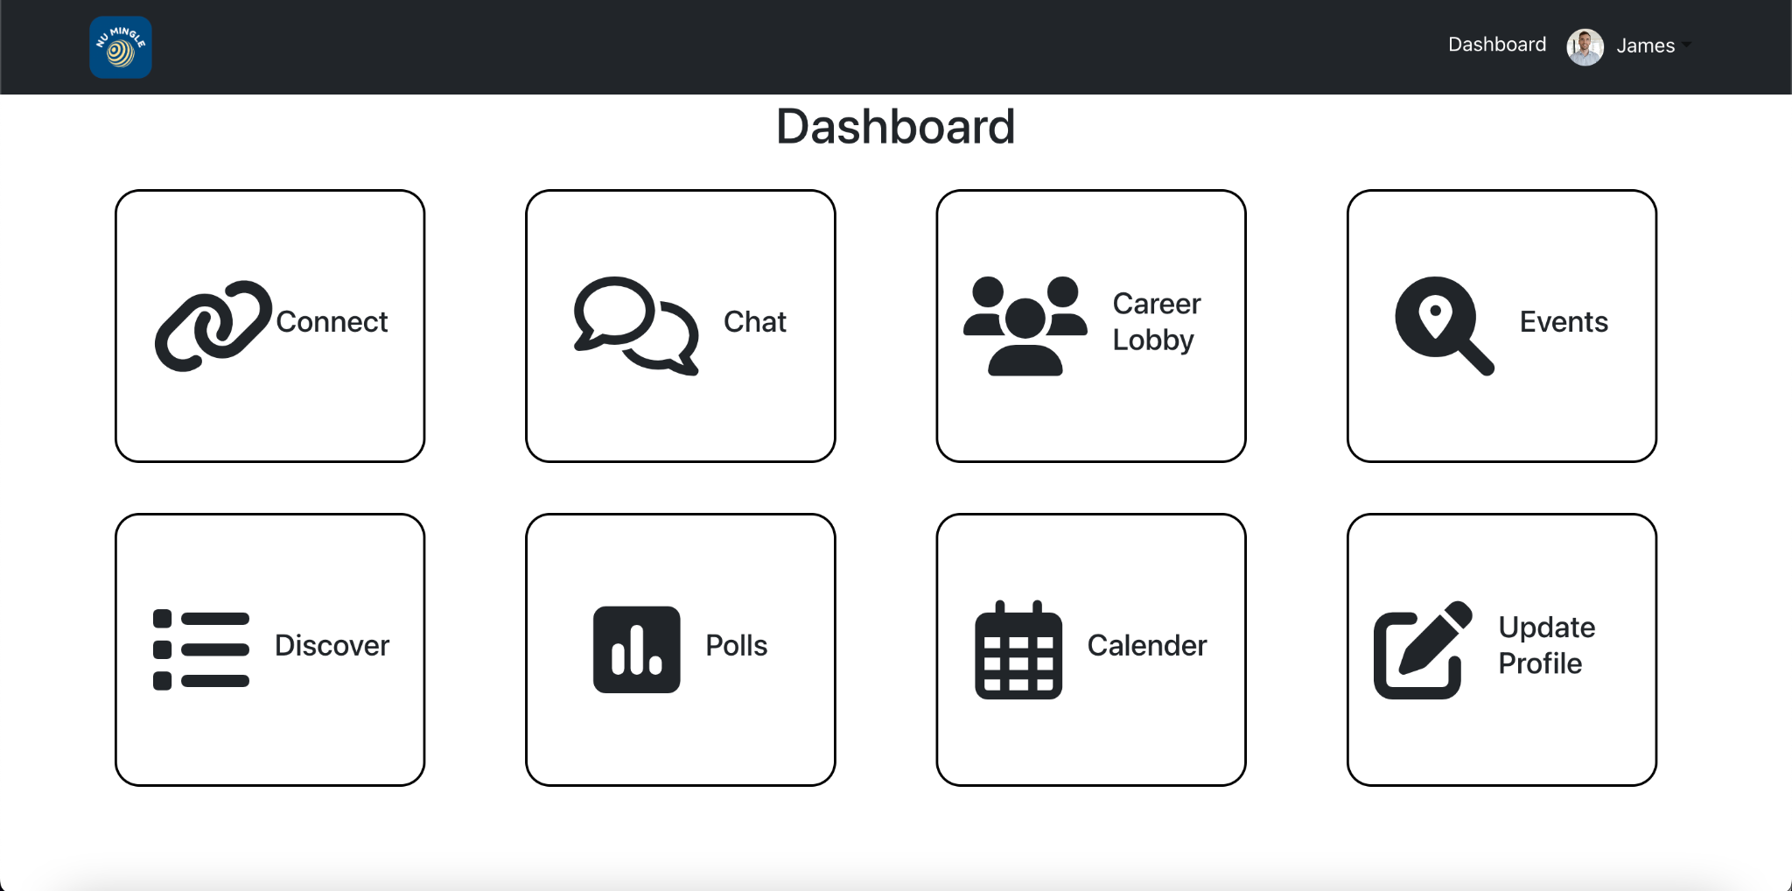
STUDENT DASHBOARD

Slide 15
Connect:
Connect functionality is used for northeastern students to connect with the peers and course colleagues.
Students can send the connection requests to the students whom they wish to connect. On the basis of that they can expand their network.
There’s three columns; one consisting of all existing users, second consisting of all connection requests sent to the user by other users which can be accepted or rejected and third all of the user’s connections that has an option to remove

Slide 16
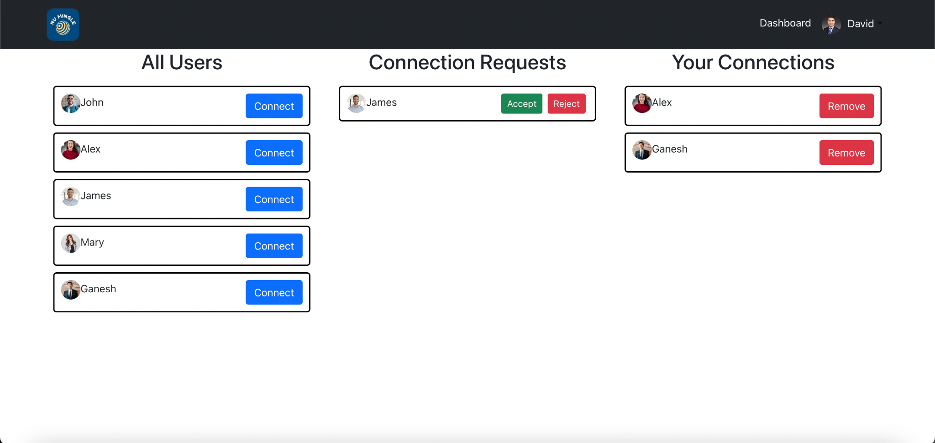
Connect

Slide 17
2.Chat Lobby
Chat functionality is a messaging platform through which students can communicate with their connections. Student's will be able to fetch and post messages to their connections.
Through chat you can communicate with any of the other users and check their availability status.

Slide 18
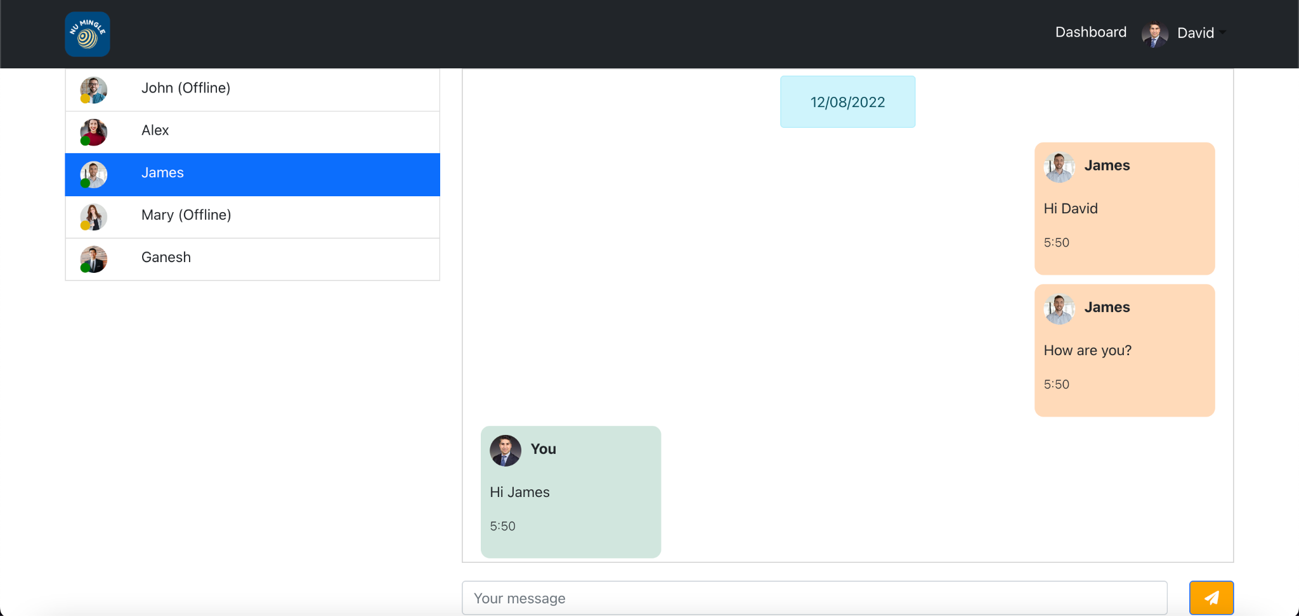
2. Chat Lobby

Slide 19
3. Career Lobby
Career lobby functionality is a messaging platform through which students can communicate with the existing career discussion groups.
These groups consist of multiple other users than can discuss on a specific topic in that lobby

Slide 20
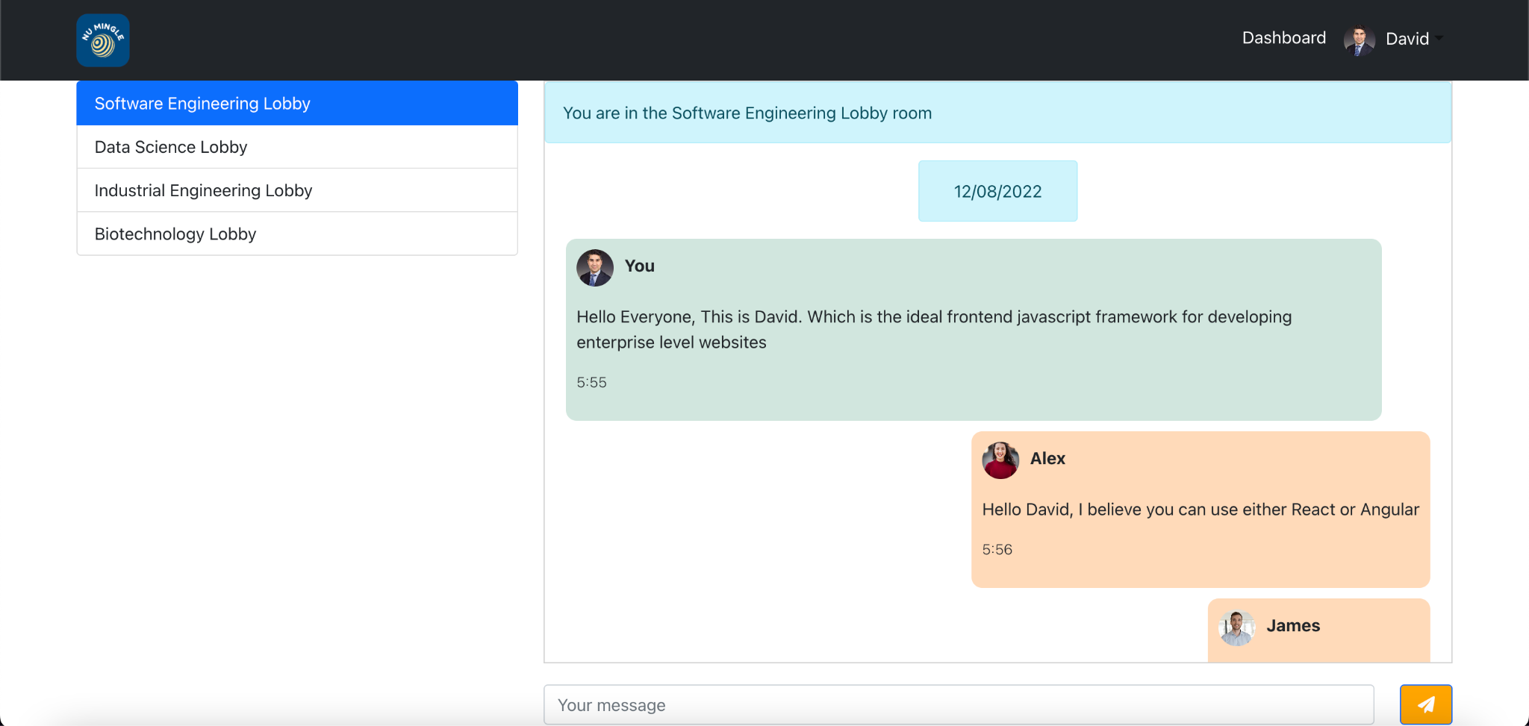
3.Career Lobby

Slide 21
4. Events
Student's can view and register for the events happening in the university.
Admin registers and modifies the details of the events.
The students then view and register for these events. They can also get directions to the location of the event from the Google Maps functionality.

Slide 22
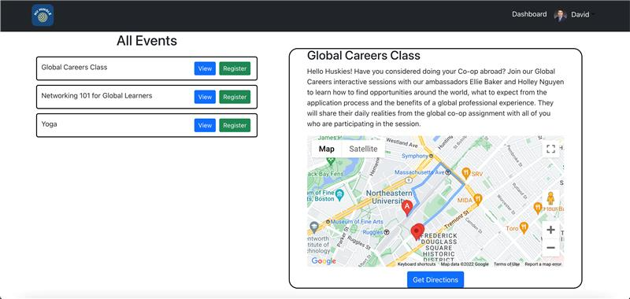
4.Events

Slide 23
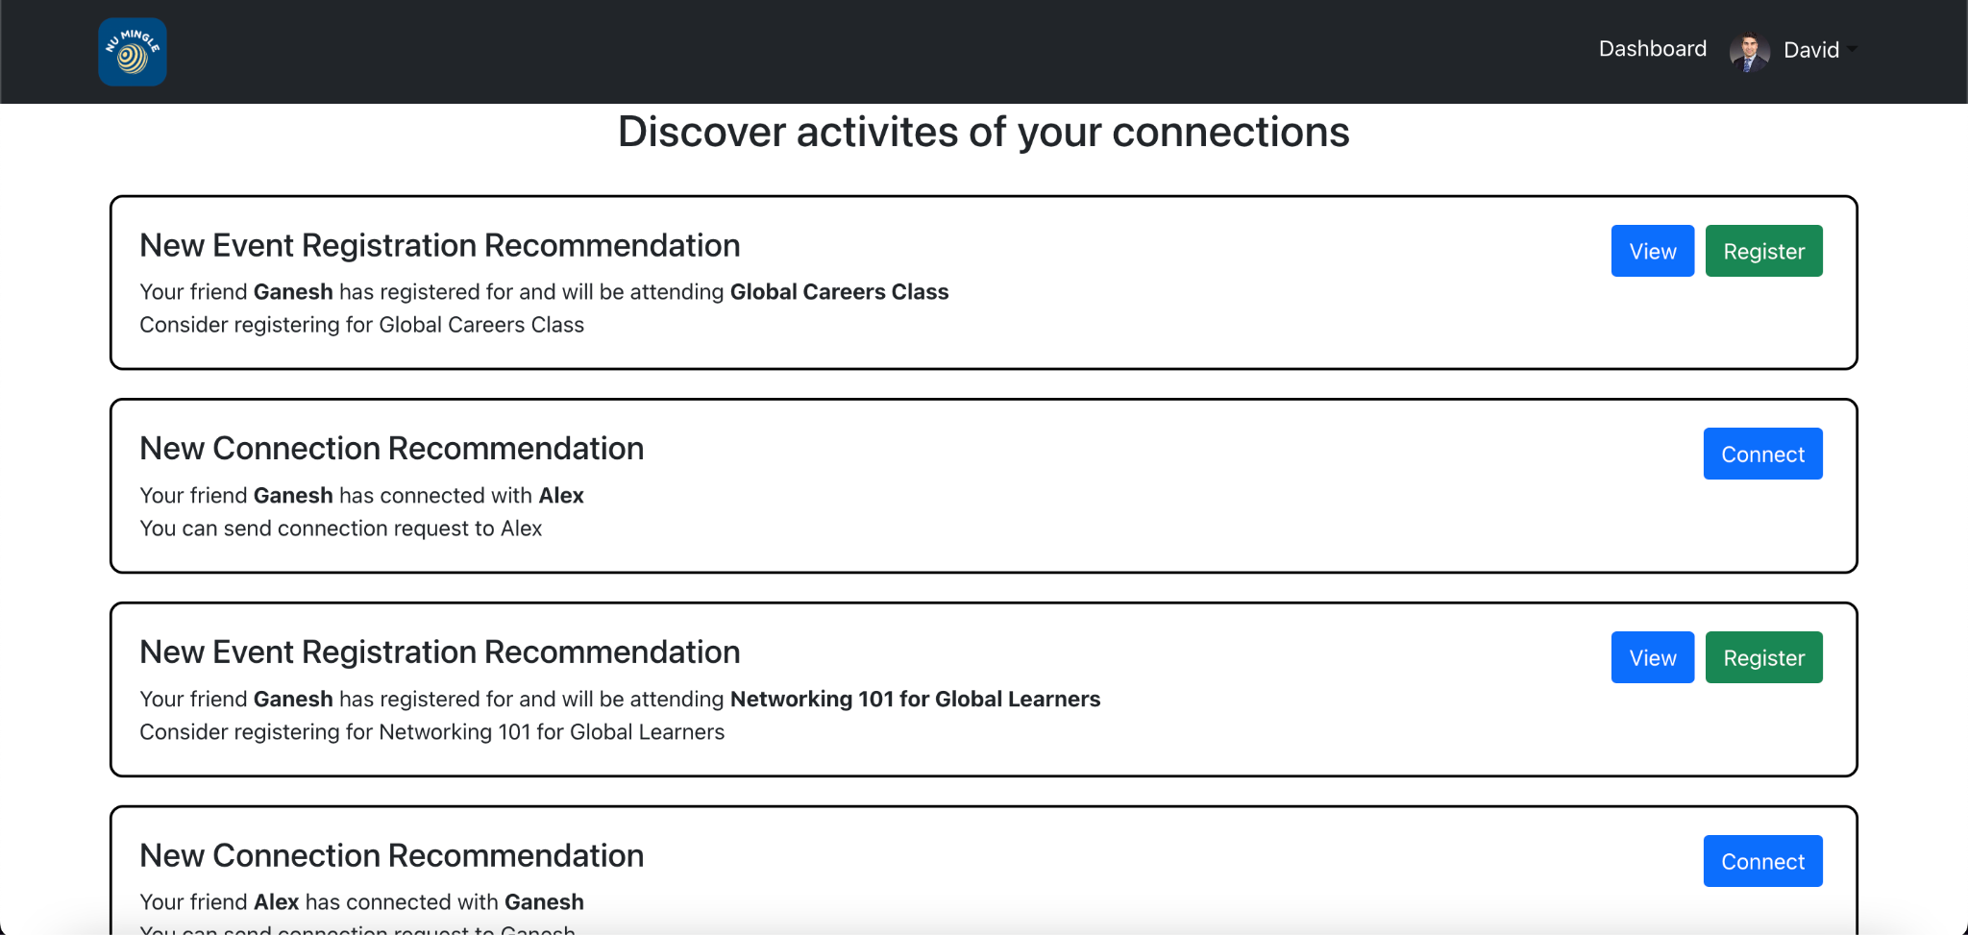
5. Discover
Discover notifies the user of the events registered by their connections
It also recommends other users to connect with that a user’s connections are connected to

Slide 24
6. Polls
It is used for collecting review and response from students related to events and trending things happening around university
Poll will be created by the admin and students can vote and visualize the results.

Slide 25
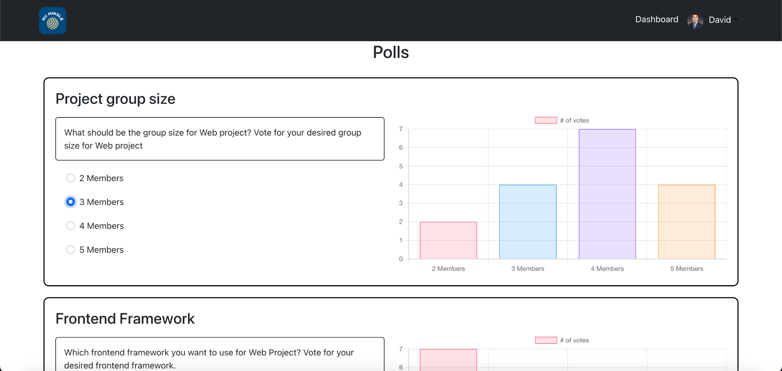
6. Polls

Slide 26
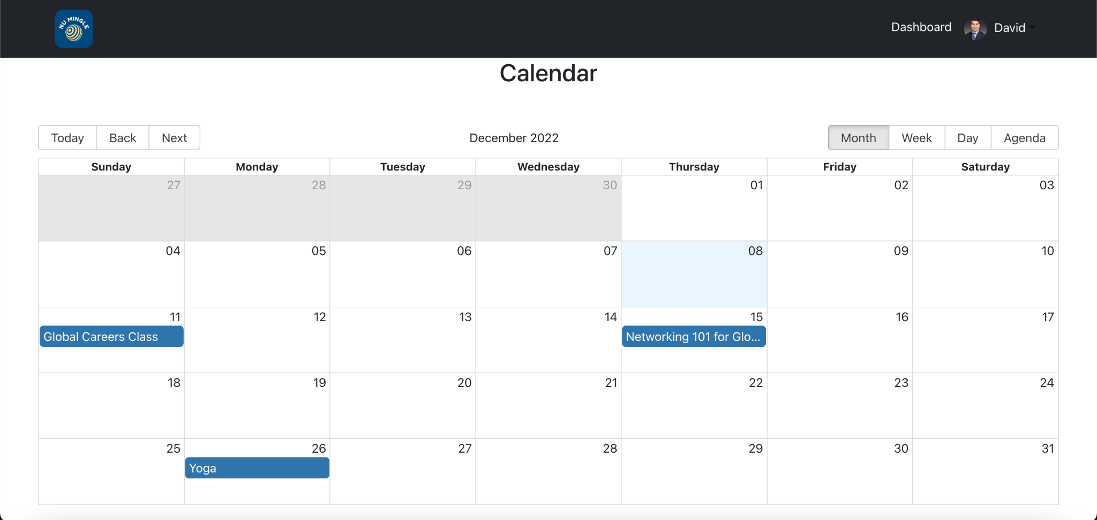
7. Calendar
Student's can visualize all the event's that hey registered for in Events on the calendar.

Slide 27
ADMIN DASHBOARD
The admin dashboard consists of the following features:
Add Events The Admin can add the Title,Description, Set Location,Event Date and Event time of the event
Add Polls The Admin can create a pole with a Title, Description and Options and post it
View Events The Admin can view the events happening in the university.
Poll Results The Admin can view the results of the Poll voted by the Students.
All Students The Admin can view all the students and their details

Slide 28
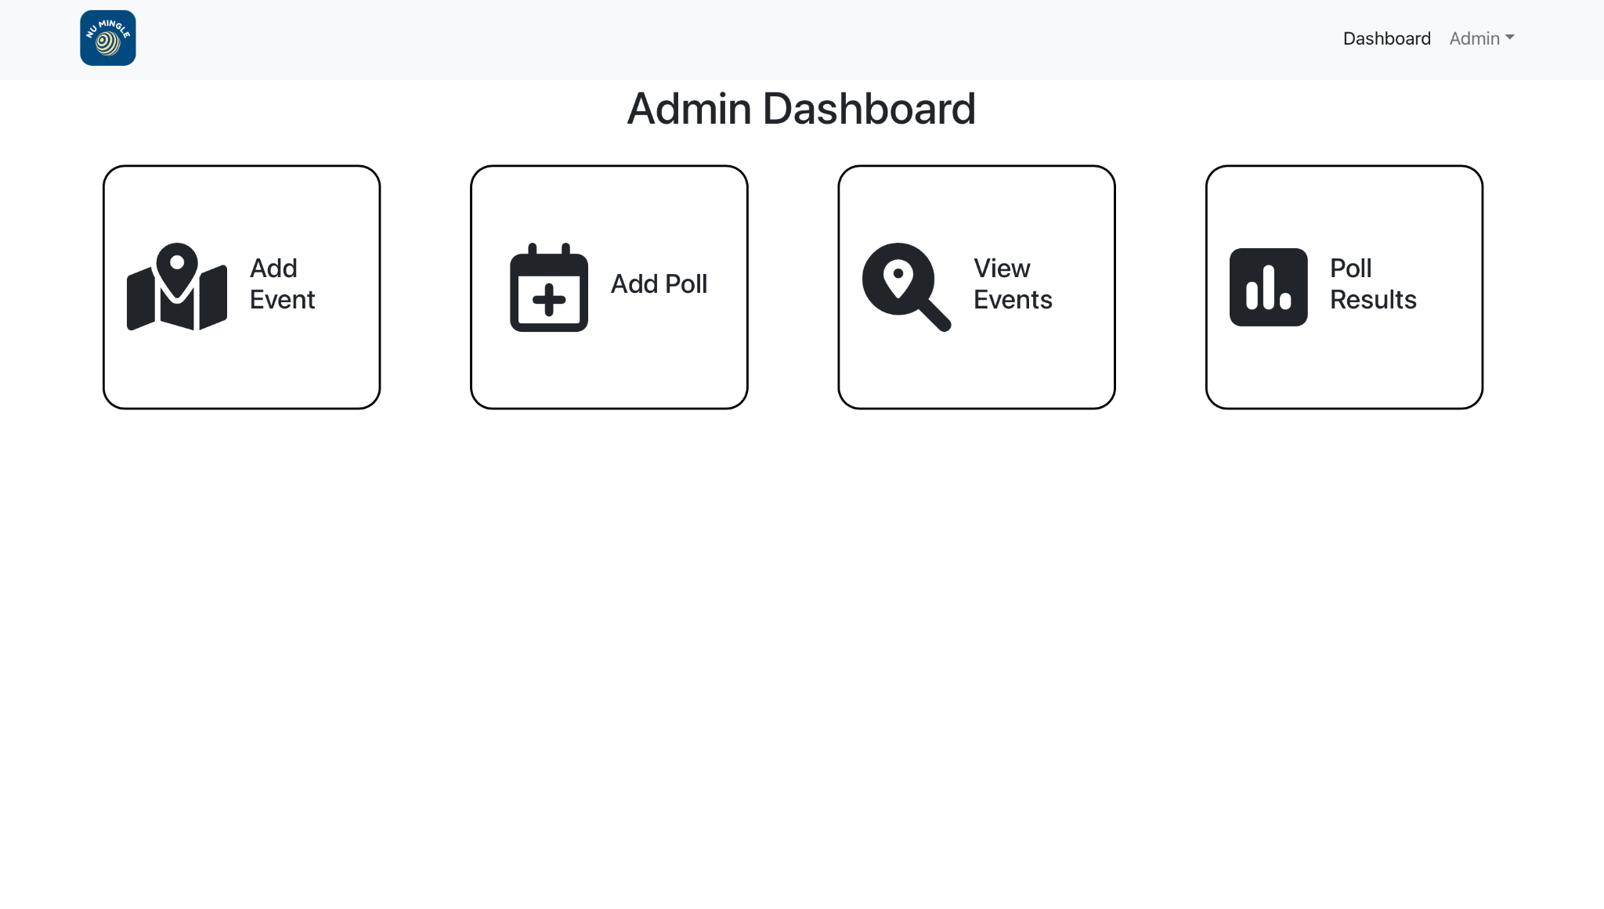
ADMIN DASHBOARD

Slide 29
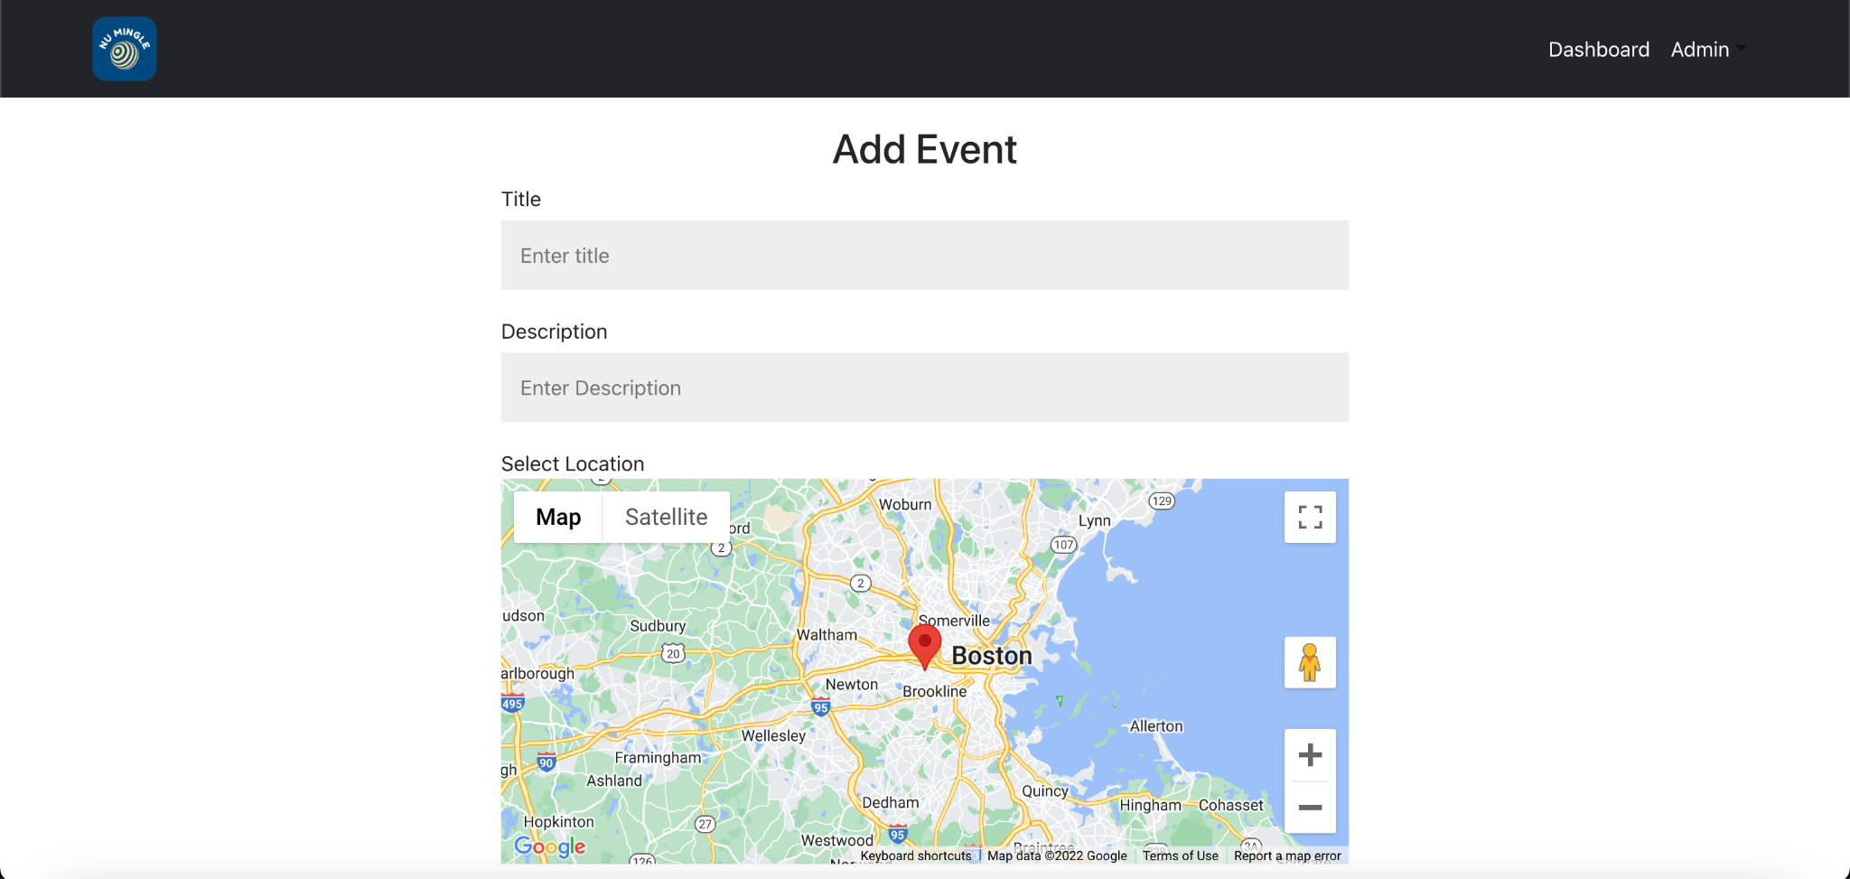
1.Add Event

Slide 30
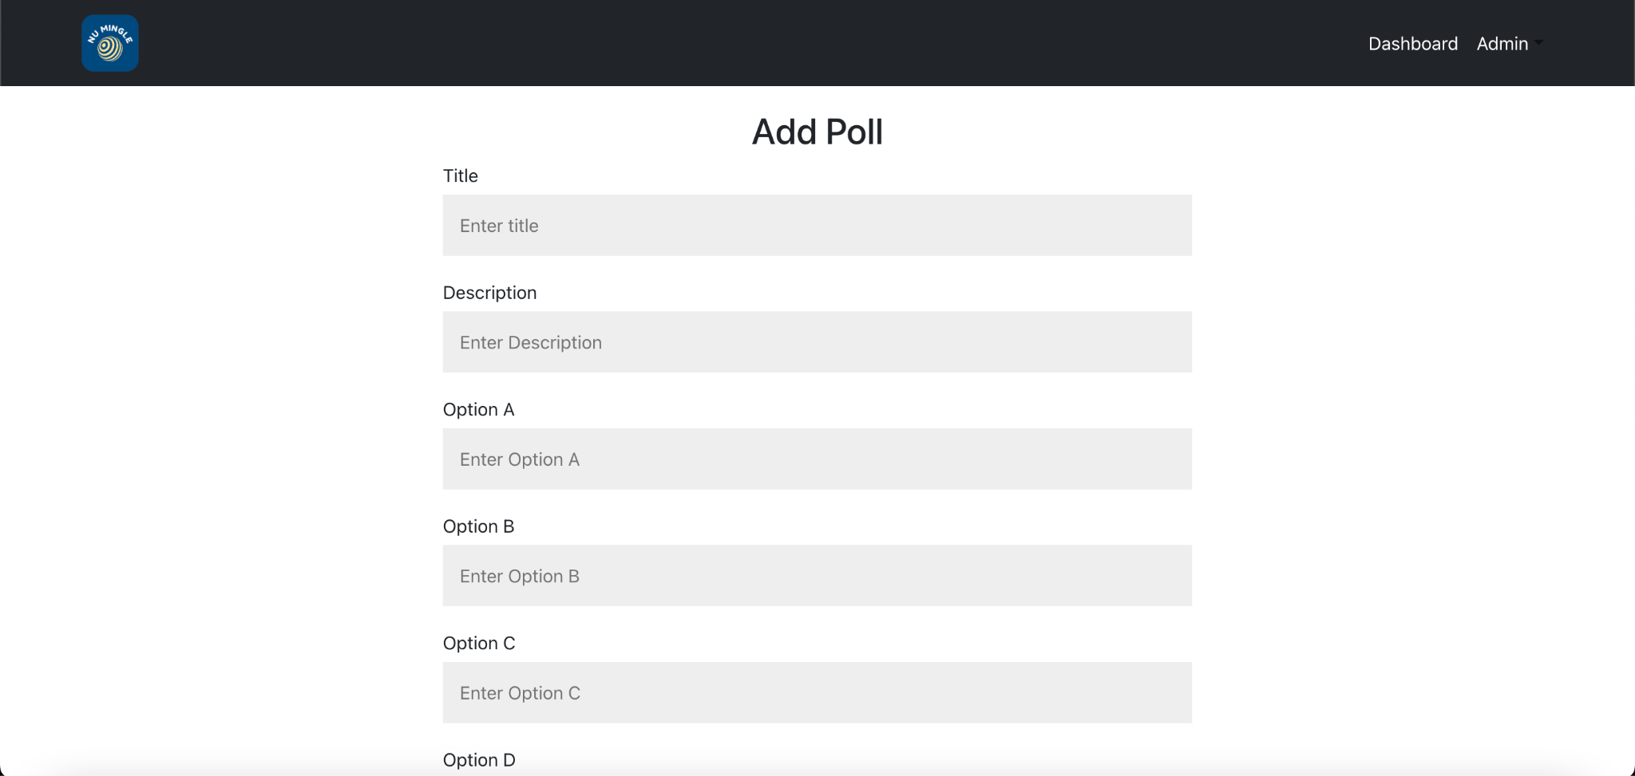
2. Add Poll

Slide 31
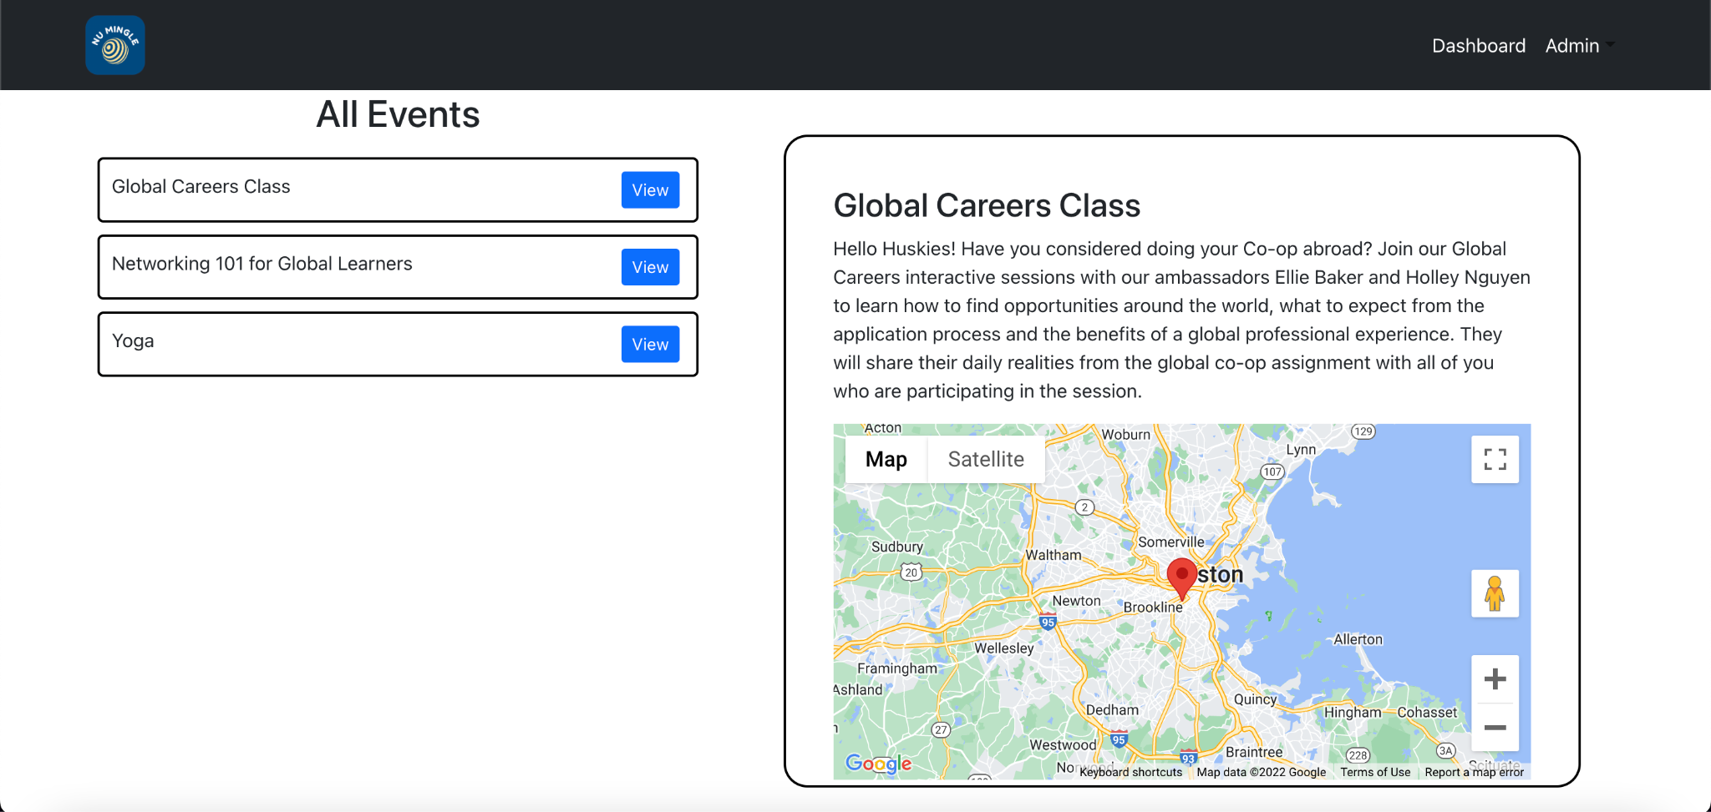
3. View Events

Slide 32
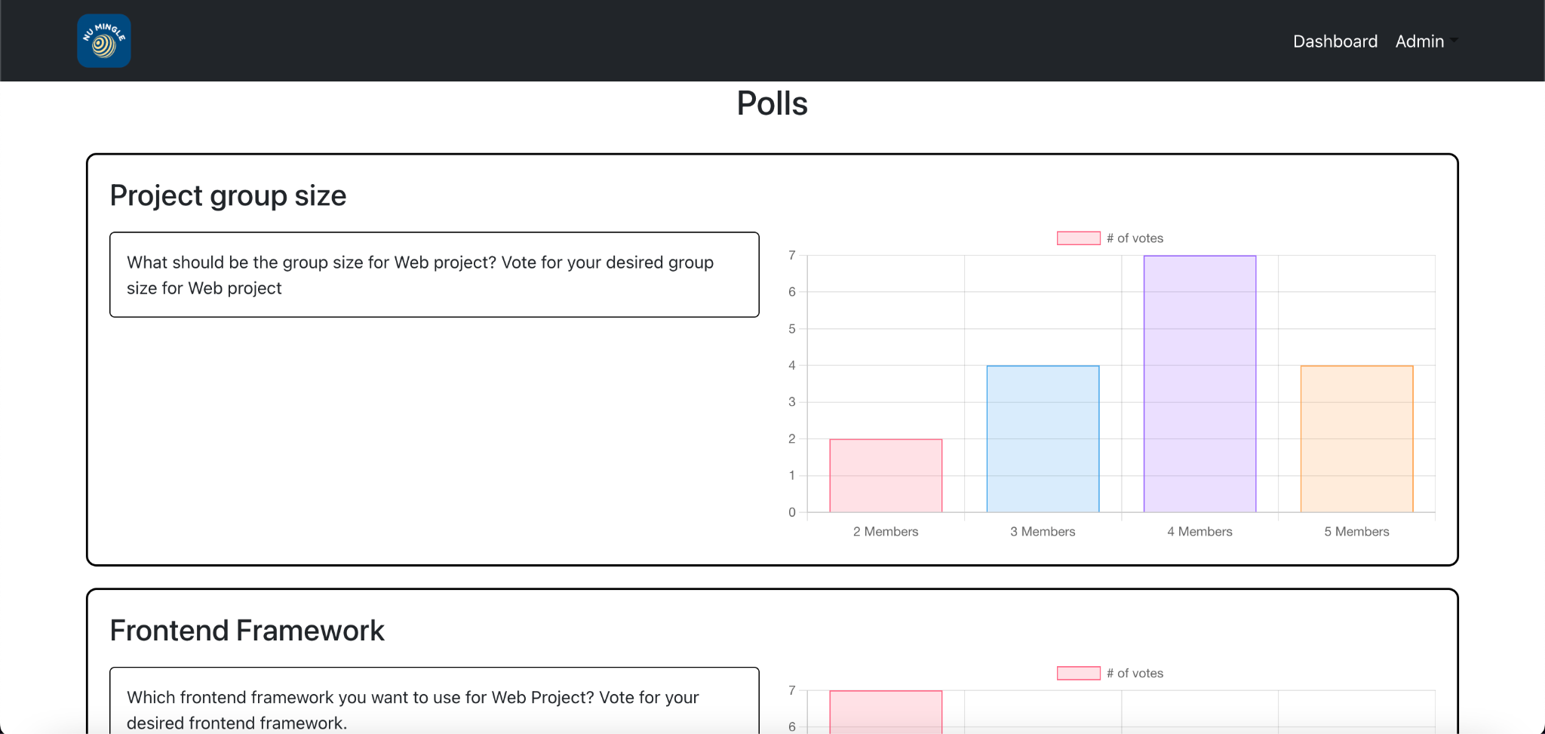
4. Poll Results

Slide 33
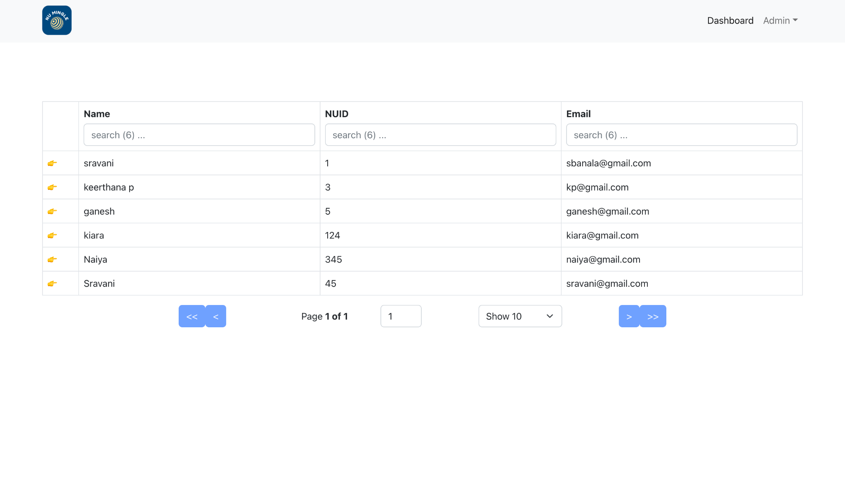
5. All Students

Slide 34
Technology Used
04
1. MONGODB
2. EXPRESS
3. React JS
4. NodeJS
5. SCSS
6. REST API
7. HTTP
8. HTML
9. JAVA SCRIPT

Slide 35

Any questions?
Thank you for your time! ☺

